Slide 1

v
Genetic Toxicology and Dose Response Data
Dr. George Johnson,
Associate Professor, Swansea University
Co-Chair, HESI GTTC and Quantitative Group
Co-Chair, IWGT 2022 Quantitative Group
Member, Committee on Mutagenicity (COM)
Other roles not relevant for todays talk.
Views and statements are my own and don’t represent opinions from the different groups above.

Slide 2
Today’s talk
George Johnson will present on quantitative methods and framework around interpreting genotoxicity data, specifically potency estimation, prioritization, and in vitro to in vivo extrapolation.
Potency estimation
Prioritization
In vitro to in vivo extrapolation

Slide 3
Overview
Dose response analysis.
In vivo.
Gollapudi et al., 2013. GTTC
Johnson et al., 2014. GTTC
Dose response analysis. In vitro
Wills et al., 2016 A and B. GTTC
Litron GeneToxPi. GTTC
Advanced BMD analysis
Haber et al., 2018
Slob, 2018
Euromix Project
MacGregor et al., 2015a
MacGregor et al., 2015b
Zeller et al., 2017.
Wills et al., 2017. GTTC
Heflich et al., 2020
Dearfield et al., 2016
White et al., 2020
Johnson et al., 2021. GTTC
Luitjen et al., 2019. GTTC
Nicolette et al., 2021. GTTC
Chepelev et al., 2022 GTTC
Issues overcome to use genetox PoD
Risk Assessment
Issues Overcome:
Justification for quant interpretation of genetic tox dose-response data.
Best way to determine a dose-response reference point, i.e., dose that elicits meaningful increase in response
Issues Overcome:
Covariate analysis on genetox data
Issues to Overcome
How best to present multiplex data and potency ranking together.
Standardizing covariate analysis
Issues Overcome:
Model selection
Model averaging
Mixture analysis
Issues to Overcome
Standardizing mixture analysis
Issues Overcome:
CES for genetox endpoints
Interpretation of BMDs relative to NOAEL/LOAEL
Mutation as a Tox Endpoint for Regulatory Decision Making
Issues Overcome:
Best way to calculate a human exposure limit and/or MOE
Issues to overcome
CES values for more endpoints.
Uncertainty factor values for genetox data?
Study Design
Notes:
Mention impact. Use of BMD on genetox data since Gollapudi paper

Slide 4
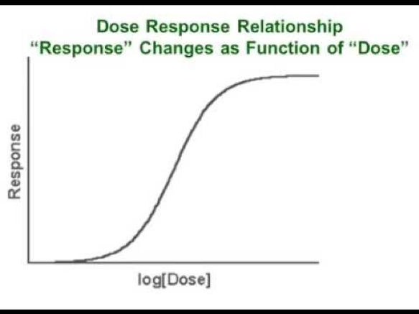
Conceptual Framework for Quantitative Analysis
Genotoxic Effect
BMDLx
Background Incidence
Concentration/Dose In vitro/in vivo
Uncertainty/Adjustment Factors
(interspecies, intraspecies, study duration, etc.)
Negligible risk for humans
Higher risk for humans
HBGV – Health-based Guidance Value
Assumption: At HBGV cellular protection mechanisms (e.g., DNA repair pathways) not saturated → difference between response and background is negligible.
Adapted from a figure developed by Veronique Thybaud.

Slide 5
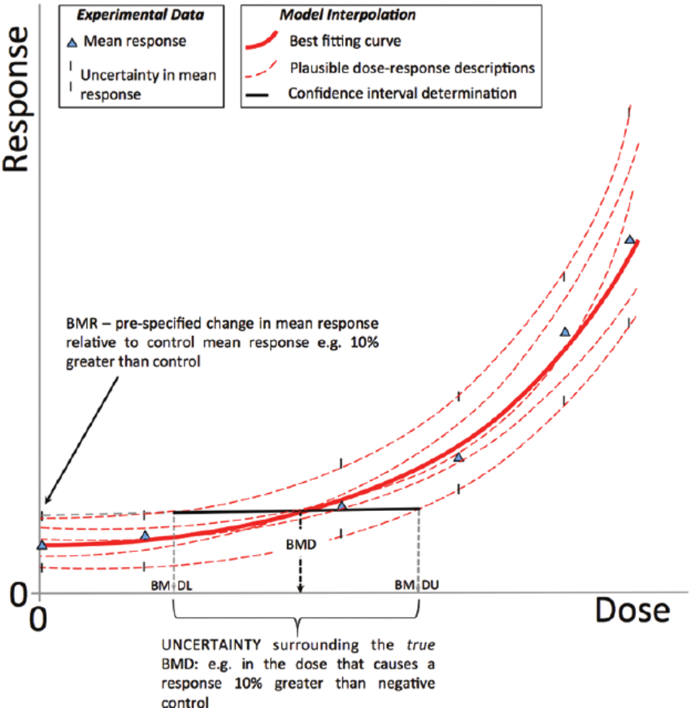
The Benchmark Dose (BMD) Approach

Slide 6
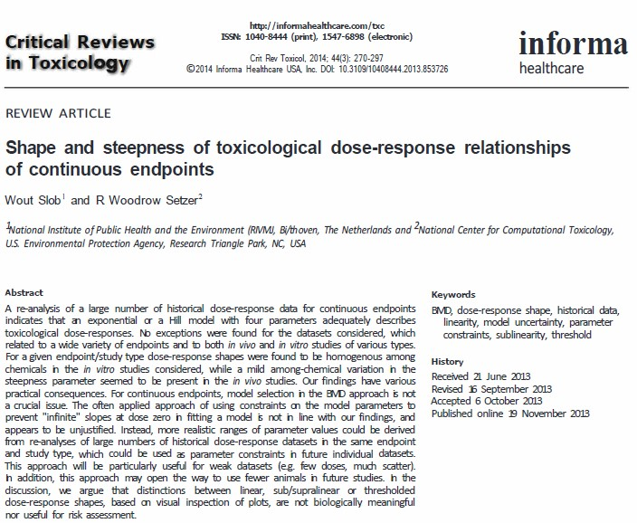
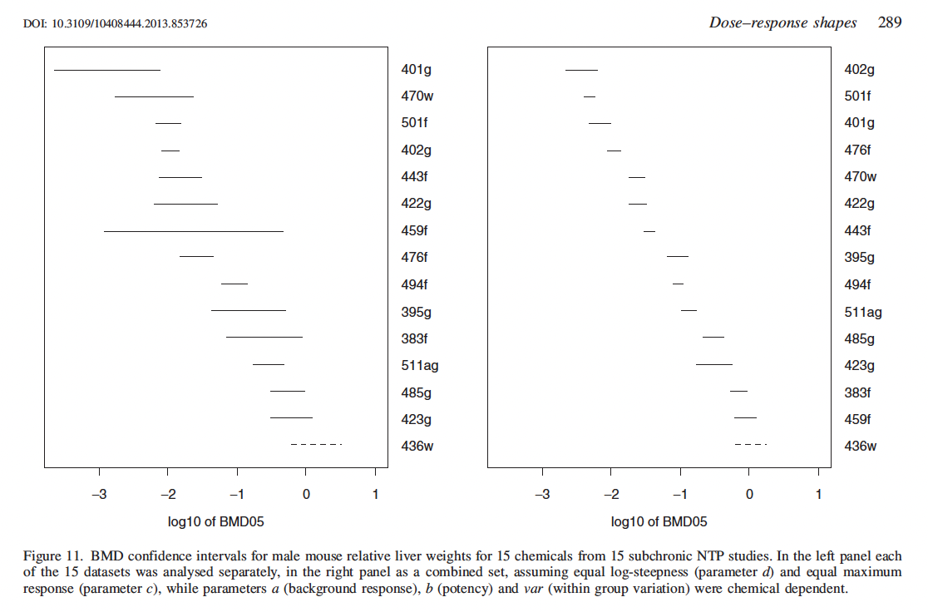
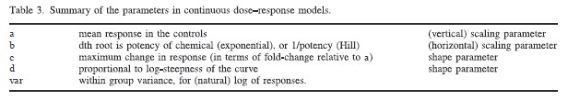

Slide 7
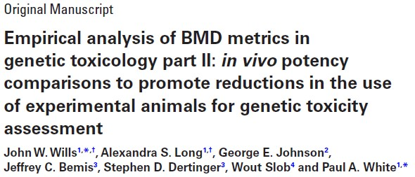
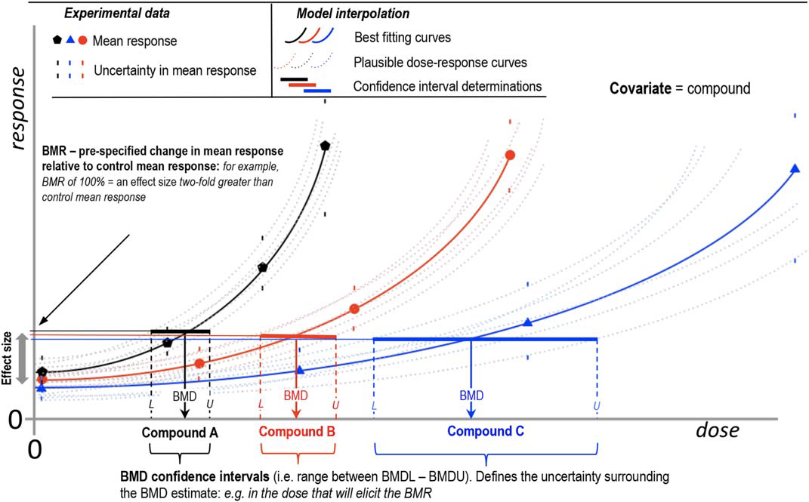

Compound A
Compound B
Compound C
Dose

Slide 8
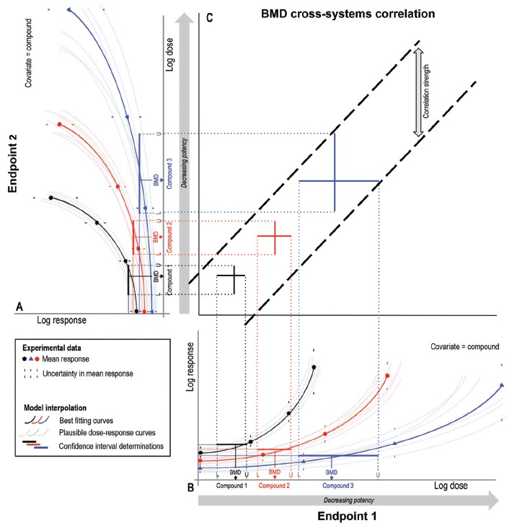
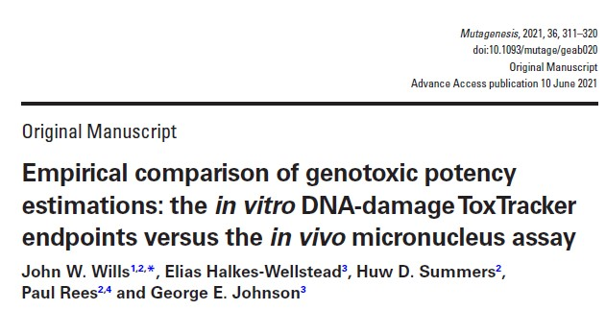
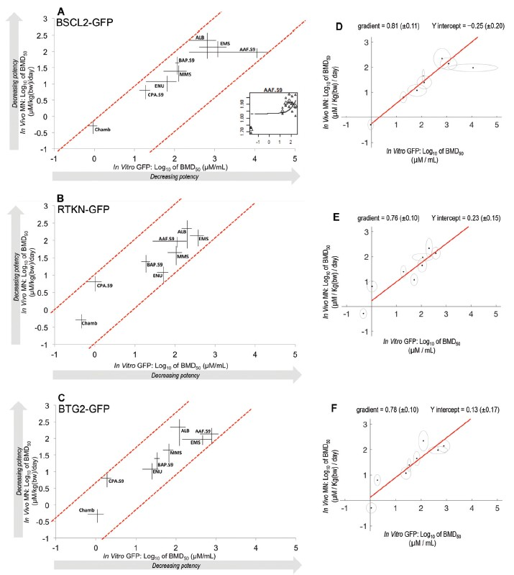

Slide 9
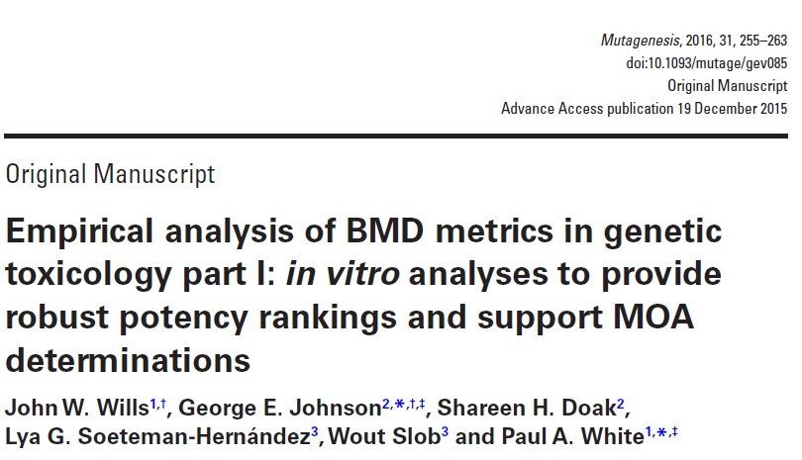
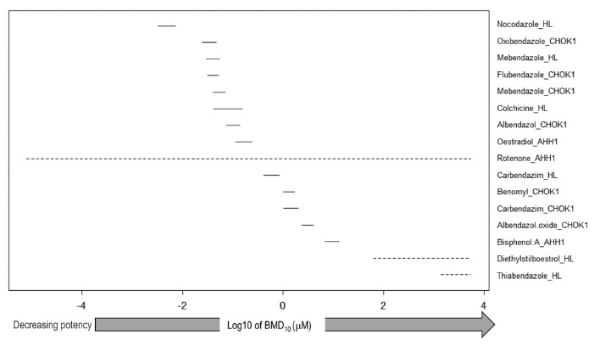

Slide 10
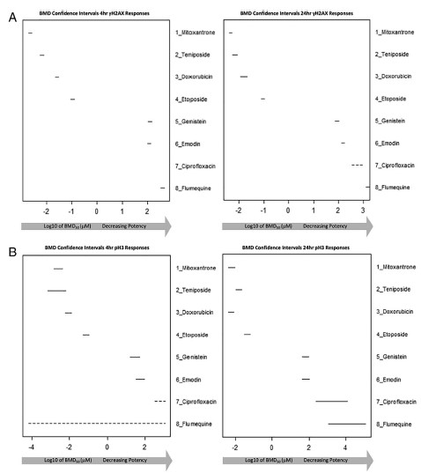
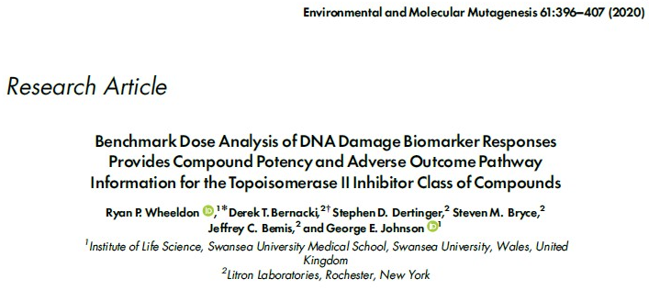
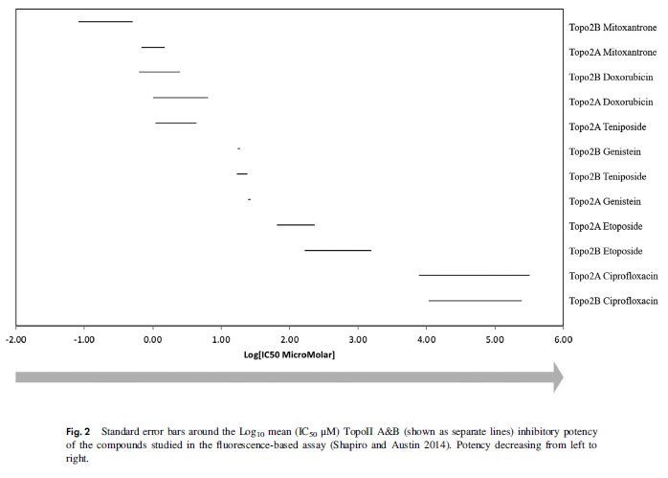

Slide 11
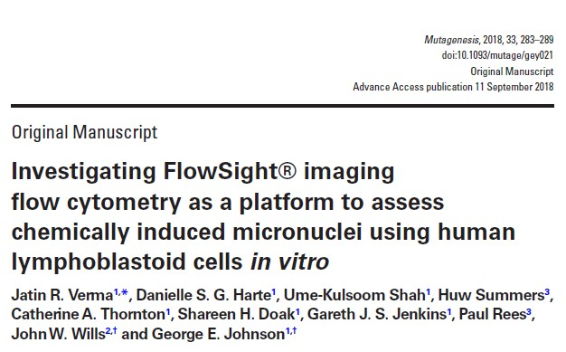
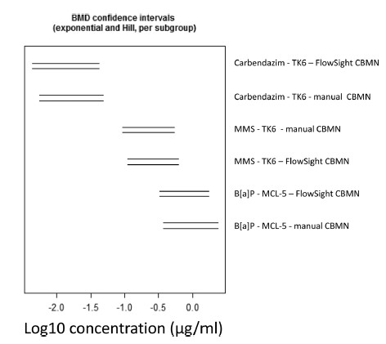

Slide 12
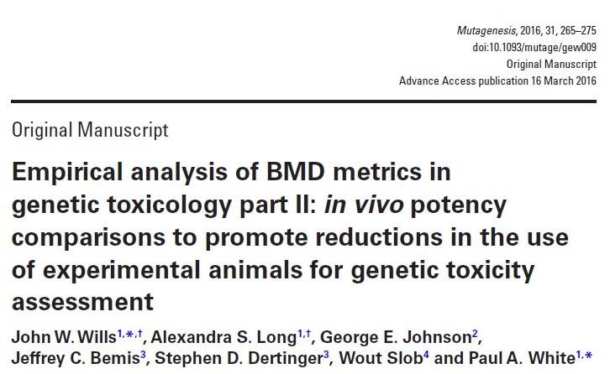
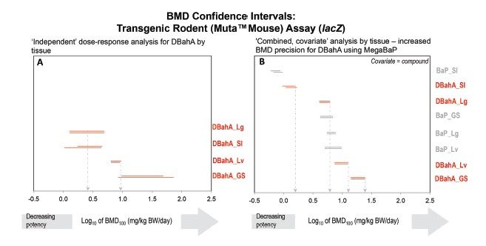

Slide 13
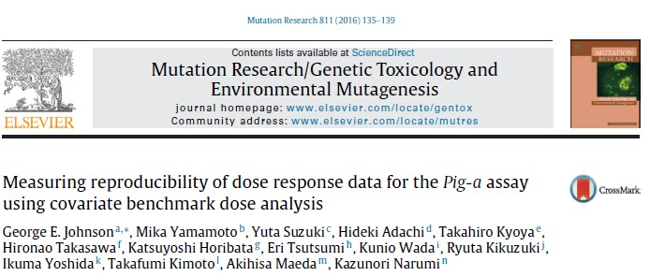
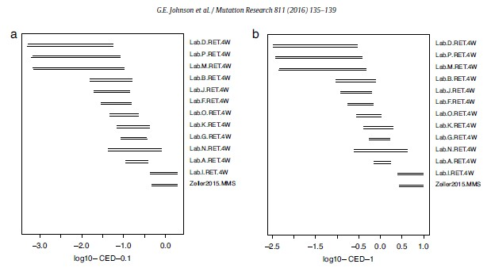

Slide 14
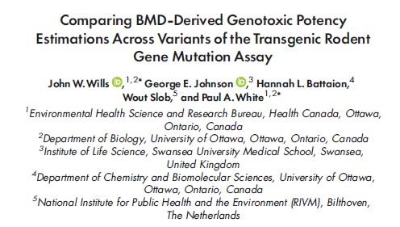
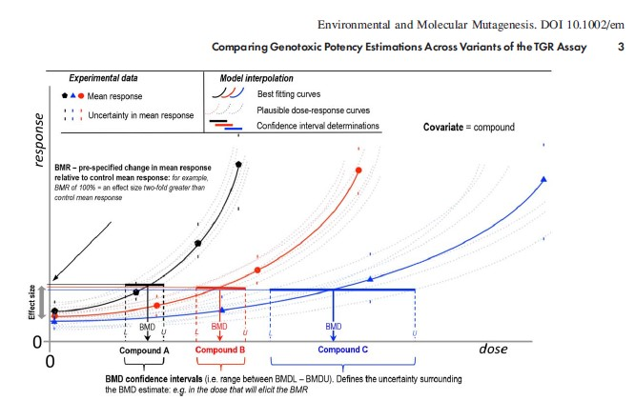
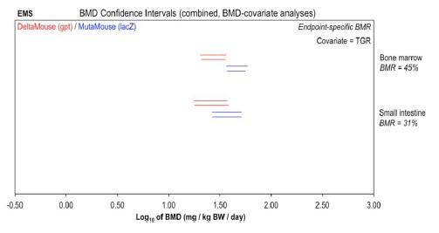

Slide 15
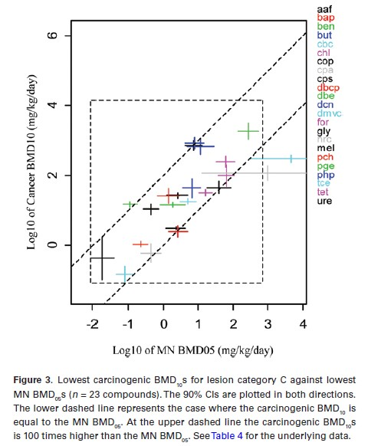
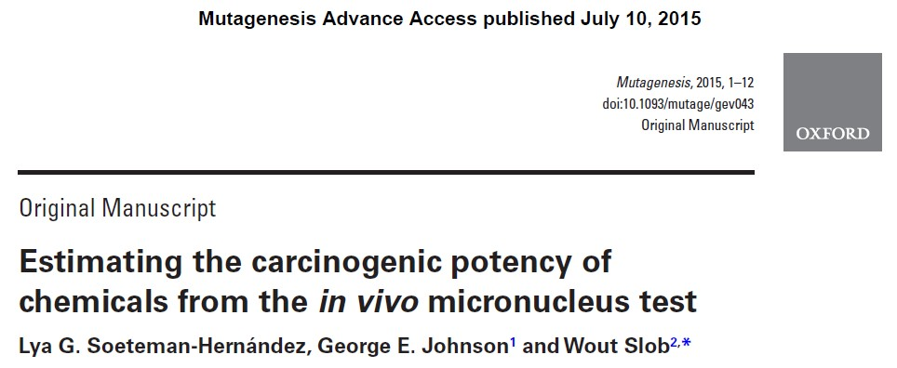

Slide 16
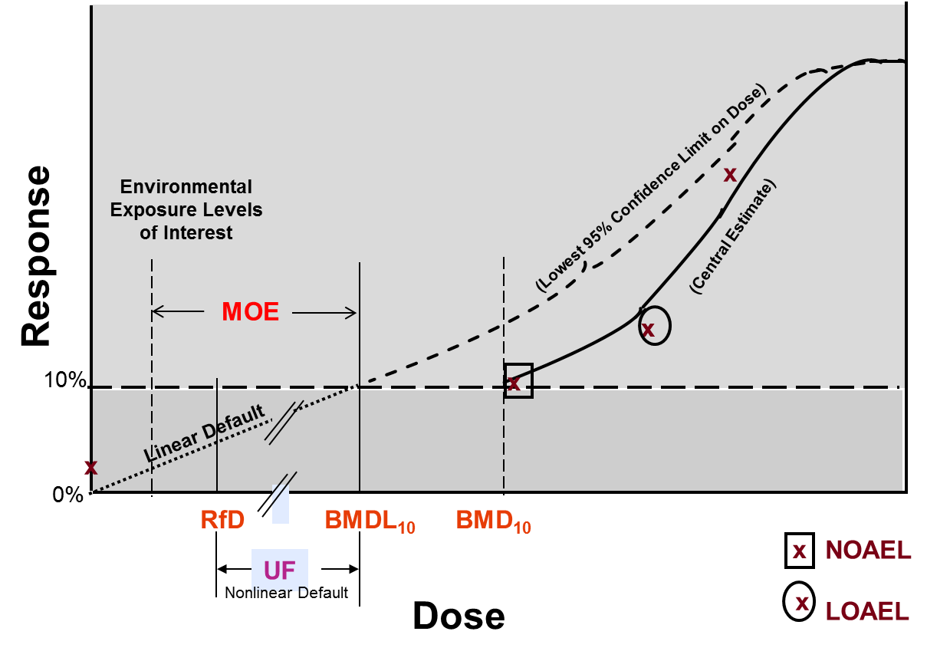
Margin of Exposure (MOE)
MOE = BMDL/estimated human exposure.
Concept endorsed by EFSA and WHO for substances that are both genotoxic and carcinogenic (EFSA, 2012).
For risk management, MOE> 10,000 → low public health concern.
No international consensus on how to “band MOEs” for denotation of high, medium and low concern (EFSA, 2012).
“Current methods for cancer risk assessment result in single values, without any information on uncertainties…..therefore, single risk values could easily be overinterpreted………single value estimates of cancer risk [are] meaningless ….. [MOE approach] avoids the misleading use of apparently precise risk numbers” Slob et al (2014) Risk Anal 34:1401-1422.
Notes:
EFSA (2012) Statement on the applicability of the Margin of Exposure approach for the safety assessment of impurities which are both genotoxic and carcinogenic in substances added to food/feed. EFSA Journal 10(3)2578.

Slide 17
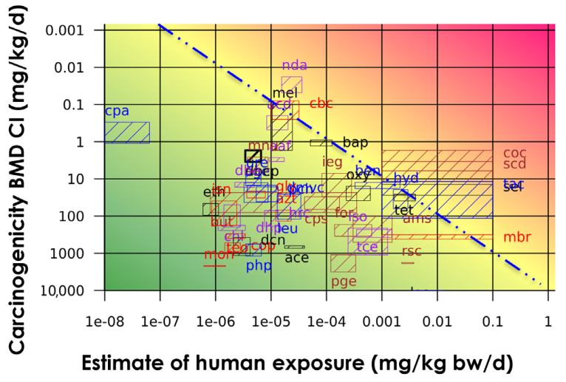
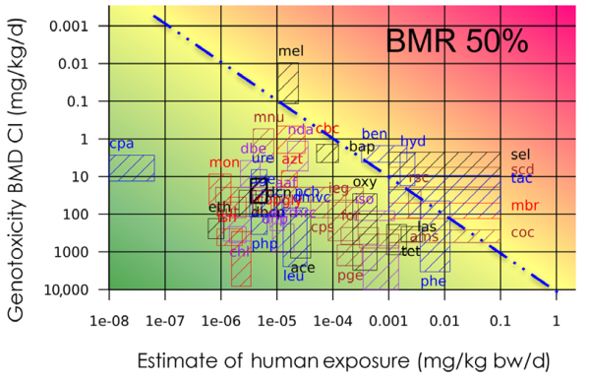
Comparison of MOE Values Derived Using Carcinogenicity and Mutagenicity Dose-Response Data
“The results indicate that regulatory decisions based on in vivo genotoxicity dose-response data would be consistent with those based on carcinogenicity dose-response data; in some cases, genotoxicity-based decisions would be more conservative. Going forward, and in the absence of carcinogenicity data, in vivo genotoxicity assays (MN and TGR) can be used to effectively prioritise substances for regulatory action.”
Source: Chepelev et al (2023) Environ Molec Mutagen, 64:4-15.
Notes:
MOE is the ratio of the PoD to the exposure level. MOE values<10,000 are cause for concern.
Genotoxicity values shown are based on MN dose-response data.
Benzene –
Cancer MOE based on BMR of 10% extra risk = 5850
MN MOE based on BMR of 50% = 717

Slide 18
“Quant” Working Group Members
Paul White, Health Canada - WG Co-lead | Bhaskar Gollapudi, Consultant
George Johnson, Swansea University - WG Co-lead | Alexandra Long, Health Canada
Andreas Zeller, Hoffmann La Roche - Rapporteur | Marc Beal, Health Canada*
Bas Bokkers, RIVM | Kerry Dearfield, Consultant
Jan van Benthem, RIVM | Lynne Haber, Univ. of Cincinnati*
Guangchao Chen, RIVM | Frank LeCurieux, ECHA
Barbara Parsons, US FDA* | Michele Kenyon, Pfizer
Bob Heflich, US FDA | Anthony Lynch, GlaxoSmithKline
Meagan Myers US FDA | John Wills, GlaxoSmithKline
David Lovell, St. George’s University | Alisa Vespa, Health Canada
Min Ge, Osaka City University | Katsuyoshi Horibata, NIHS
Stefan Pfuhler, P&G*
*Sub-group chairs

Slide 19
Overview of Sub-group Topics
Foundational Rationale for Quantitative Interpretation of Genotoxicity Dose-response Data – Paul White, George Johnson and Andreas Zeller.
Quantitative Dose-response Analysis & The BMD Approach – BMD approach and issues related to statistical interpretation of dose-response data – Sub-group leader Lynne Haber, University of Cincinnati.
Interpretation of In Vivo Dose Response Data for Risk Assessment and Regulatory Decision-making – Risk assessment and regulatory decision-making based on analysis of in vivo dose-response data – Sub-group leader Stefan Pfuhler, Proctor and Gamble Company.
Interpretation of In Vitro Dose Response Data for Risk Assessment and Regulatory Decision-making – Risk assessment and regulatory decision-making based on quantitative analysis of in vitro dose-response data and IVIVE (In Vitro to In Vivo Extrapolation) – Sub-group leader – Marc Beal, Health Canada.
Effect Severity and Interpretation of Genetic Toxicity Dose-response Data in a Human Health Context – Considerations regarding the severity of a genotoxic effects – Sub-group leader Barbara Parsons, NCTR, USFDA.

Slide 20

New Paradigm Quantitative dose-response analysis for risk assessment and regulatory decision-making

Slide 21
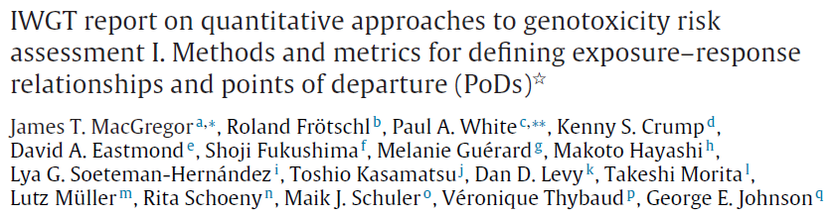
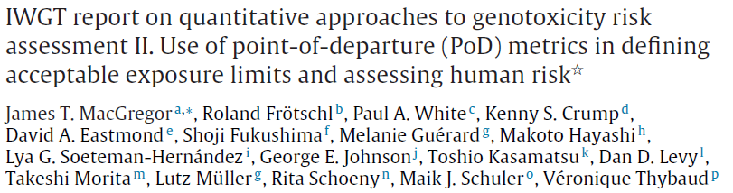
2013 IWGT – Foundational “Quant” Publications
MacGregor et al., 2015. Mutation Research, 783:66-78.
MacGregor et al., 2015. Mutation Research, 783:55-65.
Notes:
Other papers related to the groups work as well.
1.) Cao et al 2014 (EMM). Gpt, PigA, MN EMS PoDs.
2.) Mutagenesis special issue (2015) White and Johnson Editors.
3.) SOT paper from 2013 workshop.
4.) Papers from GTTC QAW workshop?

Slide 22
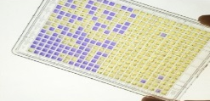
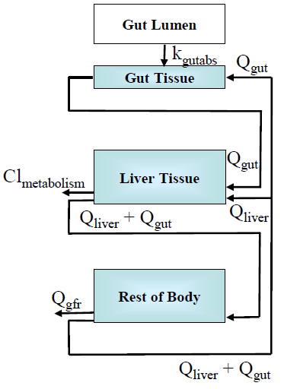
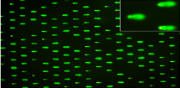
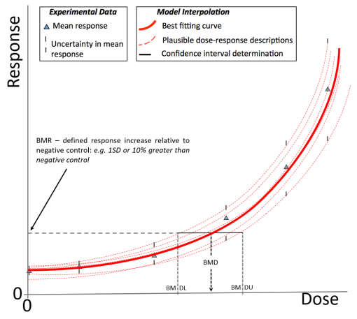
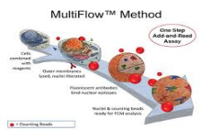
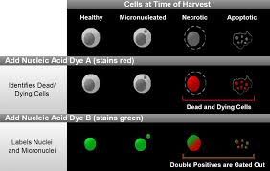
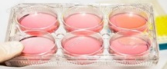
Ames II
CometChip®
IVIVE – Converting GeneTox₂₁ In Vitro Concentrations to In Vivo Doses
MultiFlow®
MicroFlow®
Concentration-Response Modeling to Determine PoD
in vitro to in vivo
Extrapolation (IVIVE)
TGR
TGx-DDI
https://mbeal.shinyapps.io/genetox21_app/
Genotoxic Administered Equivalent Dose (G-AED; mg/kg bw/day)
See: Science Approach Document (SciAD) – Bioactivity Exposure Ratio: Application in Priority Setting and Risk Assessment.
https://www.canada.ca/content/dam/eccc/documents/pdf/pded/bioactivity-exposure-ratio/Science-approach-document-bioactivity-exposure-ratio.pdf
Notes:
37 Reference Chemicals selected in consultation with international RAC

Slide 23
IVIVE Outline
Mammalian assays for in vitro genotoxicity assessment
Strategies for quantitative interpretation of in vitro concentration-response data, i.e., PoD (point of departure) determination
Toxicokinetic models to support interpretation of in vitro data in an in vivo context
Advanced in vitro systems for genotoxicity assessment
Uncertainties and limitations associated with interpretation of in vitro data in an in vivo context
The utility of in vitro for human health risk assessment regulatory decision-making
State of the Science
Persistent Challenges
Applications
Dr. Marc Beal

Slide 24
Mammalian assays for in vitro genotoxicity assessment
Category | Full assay name | Endpoint | Cell type | Can be carried out in human cells? | Metabolism | TG | High(er)-throughput option?
Gene Mutation | in vitro mammalian FE1 transgene mutation assay (i.e., FE1 TGR assay) | Transgene (lacZ) forward mutation | FE1 cells (MutaMouse pulmonary epithelial cells) | No | Metabolically competent and can be tested with S9 | No | No
Chromosomal Damage | In vitro mammalian cell micronucleus test (i.e., MNvit) | Clastogenicity & aneugenicity | Various cell lines or human or other mamalian peripheral blood lymphocytes. Validated cell lines include CHO, V79, CHL/IU (chinese hamster), L5178Y (mouse), and TK6 (human) | Yes | Can use metabolically competent cells or S9 | TG487 | Yes
Indicator | MultiFlow™ assay | DNA damage | Any, most commonly TK6 (human lymphoblastoid) | Yes | Can use metabolically competent cells or S9 | No | Yes
Indicator | ToxTracker® | DNA damage | 6 mouse embryonic stem cell reporter cell lines (GFP) | No | Tested with and without S9 | No | Yes
Indicator | PrediScreen | DNA Damage | Various human cell lines - published data in HepG2 (liver), LS-174T (colon) and ACHN (renal) | Yes | Can use metabolically competent cells or S9 | No | Yes
Dr. Alexandra Long
Notes:
Indicate not exhaustive

Slide 25
Toxicokinetic Models Supporting Interpretation of in vitro Data
A challenge with applying in vitro data in risk assessment is the lack of human equivalency.
Toxicokinetic models help establish the human dose equivalency
In vitro concentrations inducing genotoxicity can be converted into a human administered equivalent doses (AED) that are biologically relevant for risk assessment (i.e., mg/kg bw/day).
Achieved using in vitro to in vivo extrapolation (IVIVE)
Various toxicokinetic considerations need to be taken into account.
How much of the chemical makes it into the cell (i.e., in vitro disposition)?
What is the expected absorption, distribution, metabolism, and excretion (ADME) of the chemical in animals (i.e., in vivo disposition)?
Dr. Marc Beal
Administered Equivalent Dose (G-AED; mg/kg bw/day)

Slide 26
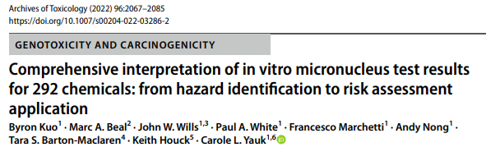
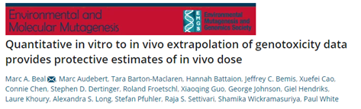
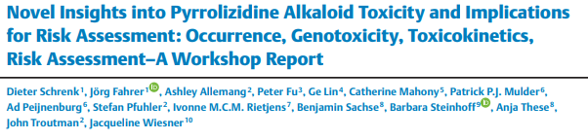
Toxicokinetic Models Supporting Interpretation of in vitro Data
There are a few recent examples where toxicokinetics modeling has been used to support use of in vitro genetox data for risk assessment.
AEDs derived from chromosome damage data for risk assessment (Kuo et al. 2022. Arch Tox 96).
AEDs derived from multiple in vitro assays tested in established genotoxicants (Beal et al. 2022. EMM).
Toxicokinetics used to support the ranking of genotoxic potency of DNA reactive plant alkaloids (Schrenk et al. 2022. Planta Med 88).
Dr. Marc Beal
Administered Equivalent Dose (G-AED; mg/kg bw/day)

Slide 27
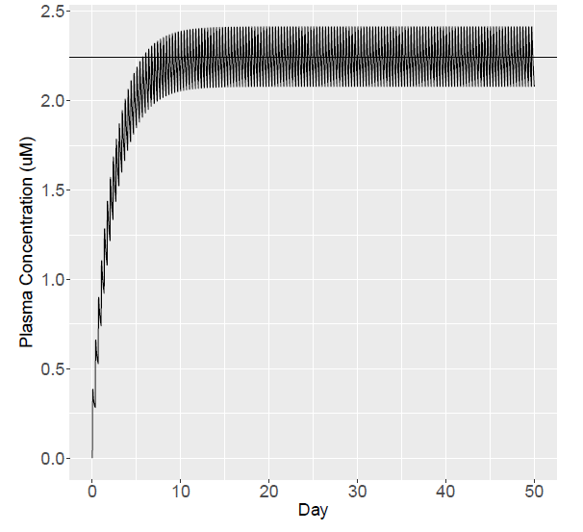
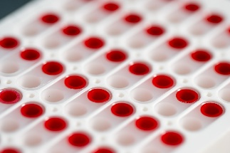

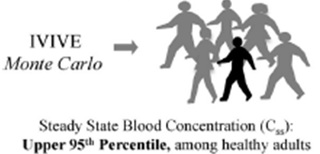
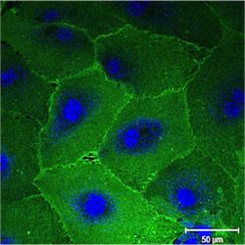
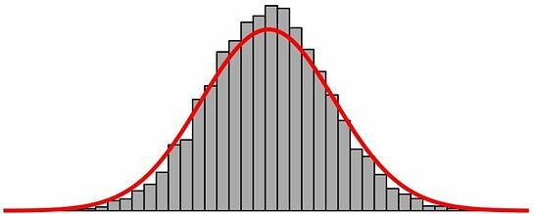
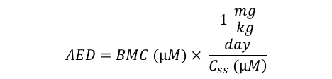

Simplified IVIVE Models Allow for Broader Implementation
Plasma Protein Binding Assay
$$\frac{AED}{BMC (µM)}= \frac{\frac{1 \frac{mg}{kg}}{day}}{\left.C_{ss} (µM\right)}$$
High-Throughput Toxicokinetics (HTTK)
$$AED=BMC (µM)× \frac{\frac{1 \frac{mg}{kg}}{day}}{\left.C_{ss} (µM\right)}$$
Hepatic Clearance Assay
Administered
Equivalent
Dose
(mg/kg-bw/day)
Distribution of C_{ss}
in silico
in vitro TK data
Pearce et al. 2017. J Stat Softw
Dr. Marc Beal

Slide 28
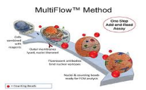
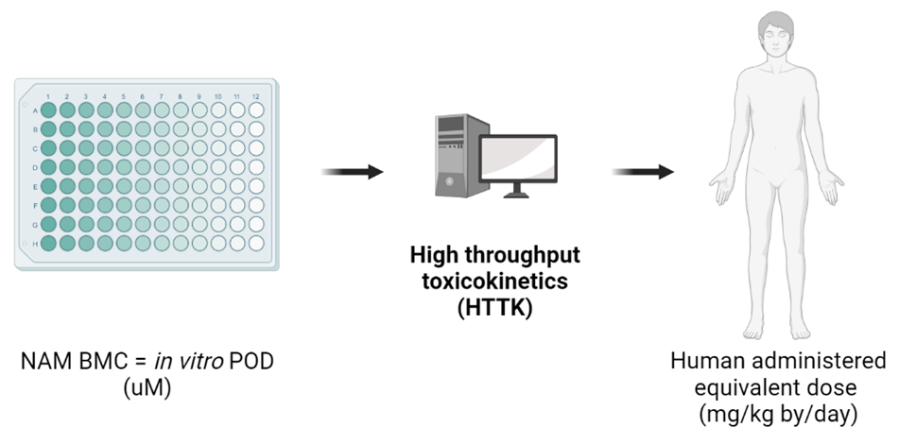
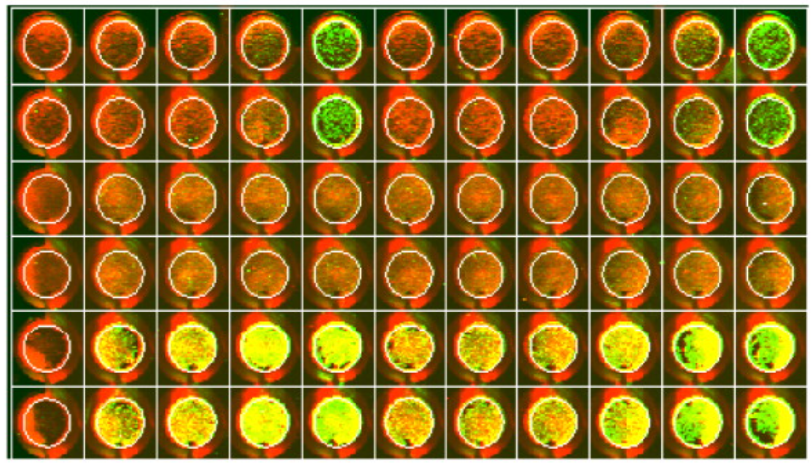


High-Throughput Toxicokinetics IVIVE Approach for Genotoxicity Assessment
Compounds with:
in vivo genetic toxicity PoDs
In vitro genetic toxicity data
Measured or estimated hepatic clearance and plasma protein binding
MultiFlow
PrediScreen
ToxTracker
In vitro mass balance model (IV-MBM) to account for in vitro disposition
(ongoing work)
in vitro to in vivo
Extrapolation using High-Throughput Toxicokinetics
MicroFlow
Benchmark Concentration Modeling (Nominal in vitro PoD)
Human Administered Equivalent Dose (AED; mg/kg bw/day)
TGR mutation
Genetic toxicity NAMs
Dr. Marc Beal
Notes:
Concentration observed to be toxic in cells converted to a human dose

Slide 29



Dr. Marc Beal

Slide 30



Advanced in vitro Systems for Genotoxicity Assessment
Extensive progress in 3D culture models representing major routes of exposure including systemic, dermal, and inhalation (Pfuhler et al., 2020. Mutat Res 850-851).
Studies using 3D liver models show higher metabolic activity and improved sensitivity for detecting genetic damage induced by genotoxicants requiring metabolic activation.
Air-liquid interfaces useful for simulating inhalation exposures of genotoxicants.
Human skin models in advanced state of validation with >decade of research
Organ-on-a-chip systems offer more realistic test environment with micro tissue cultures, tissue perfusion, microfluidic connections and the appropriate biomimetic stimulation (i.e., mechanical and electrical).
Notes:
Stimulation critical for tissue development and behaviour

Slide 31
Uncertainties & Limitations Associated with in vitro Data
Exposure scenario equivalency of in vitro data is uncertain: Does a short term in vitro study adequately capture the biology of a chronic animal study?
Metabolism uncertainties: Are the cell lines able to reproduce the metabolites and/or detoxification processes following human exposures?
Toxicokinetics models overly simple: Missing compartments, assumptions on conservative side, kinetic processes unaccounted for.
Confidence building limited to available data: Case studies have notable data gaps that make validation difficult.
Problem not unique to genetox. Too much variability across in vivo data (even within same design and endpoint). Reasonable prediction for a POD of 1 mg/kg using in vitro data is 0.08 mg/kg – 10 mg/kg (Pham et al. 2020. Comp Tox 100126)
Standardization: Development of guidelines is outpaced by rapid evolution of in vitro assays

Slide 32
Risk Assessment Applications
1) Potency ranking
Sufficiently developed and quantitative in vitro strategies already routinely used.
2) Screening and prioritization of chemicals for further evaluation
Sufficiently developed for more routine use for fit-for-purpose applications.
3) Health-Based Guidance Values and Quantitative Risk Assessments
Emerging opportunity but still in early stages of development.

Slide 33
IWGT 2022 Consensus Statements – In Vitro Sub-group Marc Beal, Health Canada Group chaired by Paul White, George Johnson. Rapporteur Andreas Zeller.
Cite as: Marc Beal, Guangchao Chen, Kerry Dearfield, et al. Interpretation of In Vitro Concentration-Response Data for Risk Assessment and Regulatory Decision-making: Report from 2022 IWGT Quantitative Analysis Expert Working Group Meeting. Authorea. June 06, 2023. DOI: 10.22541/au.168606397.73342589/v1
https://www.authorea.com/doi/full/10.22541/au.168606397.73342589

Slide 34
IWGT Consensus Summary
1) The commonly used mammalian in vitro genotoxicity endpoints (e.g. gene mutation and chromosomal damage assays) have the potential for use in quantitative applications such as the derivation of bioactivity exposure ratios (BER).
2) Initial analysis indicates that critical effect size (CES) may need to be endpoint (assay) specific. Additional data should be analyzed to give a more robust recommendation on appropriate CES for various assays and endpoints.
3) Because it is anticipated that in vivo genotoxicity data will become less available in the near future, it is critical to address the uncertainties associated with in vitro data and IVIVE to support interpretation of concentration-response data in a human health context.

Slide 35
IWGT Consensus Summary
4) As researchers build confidence in the application of more human-relevant models reflecting higher complexity, there will be opportunities to apply the data quantitatively in chemical safety evaluations. It is anticipated that higher complexity models will improve the ability to interpret in vitro genotoxicity data in the human health context.
5) Quantitative interpretation of in vitro genotoxicity data has already demonstrated utility in potency ranking, and this strategy is sufficiently developed to support screening and prioritization of data-poor substances for further evaluation. Further case studies and standardization efforts are needed before PoDs derived from in vitro data can be employed for quantitative risk assessments.

Slide 36

Data analysis exercise.
Use PROAST online. https://proastweb.rivm.nl/
Test data sent by email, also in this zip file.

Slide 37

BMD is preferable to a no observed effect level (NOEL) for most instances
Single metrics don’t have a measure of precision, confidence intervals needed. Slob, 2014
Sparse data (larger variation) leads to a higher NOEL, but lower BMDL. (MacGregor et al., 2015)
BMD is quicker and easier when analysing multiple data sets.

Slide 38
Hardy et al., 2016. EFSA. Update: use of the benchmark dose approach in risk assessment. https://efsa.onlinelibrary.wiley.com/doi/epdf/10.2903/j.efsa.2017.4658

Slide 39
Data analysis exercise.
Use PROAST online. https://proastweb.rivm.nl/
Test data sent by email, also in this zip file.

Slide 40




3.Data.Covariate
Dose. ug.ml | Response.Perc.Cells | Study
0 | 0.8 | 1
0 | 1 | 1
0 | 1.1 | 1
1 | 0.9 | 1
1 | 0.6 | 1
1 | 1 | 1
3 | 1.2 | 1
3 | 1.5 | 1
3 | 1 | 1
9 | 2 | 1
9 | 2.5 | 1
9 | 3.2 | 1
27 | 4 | 1
27 | 4.5 | 1
27 | 3.5 | 1
0 | 1.04 | 2
0 | 1.3 | 2
0 | 1.43 | 2
2 | 1.17 | 2
2 | 0.78 | 2
2 | 1.3 | 2
4 | 1.56 | 2
4 | 1.95 | 2
4 | 1.3 | 2
6 | 2.6 | 2
6 | 3.25 | 2
6 | 4.16 | 2
8 | 5.2 | 2
8 | 5.85 | 2
8 | 4.55 | 2
0 | 1.5 | 3
0 | 2 | 3
0 | 0.5 | 3
0.01 | 1 | 3
0.01 | 2 | 3
0.01 | 3 | 3
0.05 | 3 | 3
0.05 | 4 | 3
0.05 | 5 | 3
0.2 | 6 | 3
0.2 | 7 | 3
0.2 | 8 | 3
subgroup | BMDlower.ma (ug/ml) | BMDupper.ma (ug/ml)
1 | 5.08 | 7.55
2 | 3.21 | 4.8
3 | 0.02 | 0.157
Notes:
Data are continuous

Slide 41


Acknowledgements
Mark Beal and Paul White, Health Canada.
IWGT 2022 – International Workshop on Genotoxicity Testing.
HESI GTTC.
Merck, Pfizer and Gilead – NDEA slides. GSK – NDMA slide.
In Vitro Toxicology Group, Swansea University
Conversations with numerous scientists on this topic, from industry, academia and government.

